Slide 1
GitHub
By: Siana Pietri
R-Ladies (Tampa)

Slide 2
Contents:
What is GitHub?
What is the Value of GitHub?
Getting started with GitHub
Uploading Code (repositories, commits, pulls, branches)
GitHub Interaction
Creating Websites
Posting your packages

Slide 3
WHAT IS GITHUB?
GitHub is a, “code hosting platform for version control and collaboration”. [1]
GitHub allows users to create groups, post materials, and share data.
Repositories
Data Science Teams and Research Groups
Independence and controls
Version control allows GitHub users to add/edit code.
Switching between revisions
Record of changes
Great for groups sharing code [University of Leicester]

Slide 4
What is the Value of GitHub?
Version Control
Easy Collaboration
User Feedback
Research Process Transparency
code, notes, replication
Move past the “techy”
Blogs
Websites
Technical LinkedIn
R Packages (w/o publication by CRAN)

Slide 5
Getting started with github
Create an account: https://github.com/
Pick a plan (free)
Go through the demo
Add your code
Video setting up a GitHub account: https://www.youtube.com/watch?v=I8OGpfnq_wY

Slide 6
Uploading Code
Some main elements of GitHub are repositories, branches, and commits.
Repositories store everything to do with projects [GitHub].
Datasets, code, spreadsheets
R packages
README*
Branches are part of a repository [GitHub].
Master
Others for work and practice
Or extra information
Commits add new code and or changes to the master branch
Video on repositories, branches and commits: https://www.youtube.com/watch?v=S3DZUwxJGNg

Slide 7
Interaction
Interaction encompasses pull requests, commenting on others code, and sharing information.
Pull Requests state that you are wanting others to comment and change your code or that you are changing others code [GitHub].
Within Pull Request others can comment and the originators of code can interact with those who have suggestions or find bugs.
Picture 1: https://github.com/tidyverse/ggplot2/issues/2393
Picture 2: https://github.com/tidyverse/ggplot2/pull/2754

Slide 8
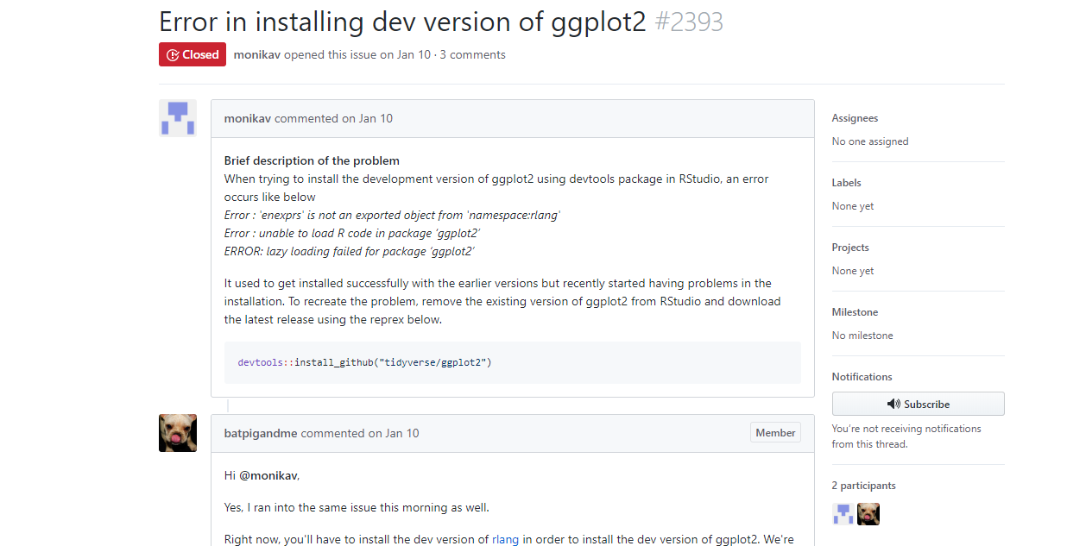

Slide 9
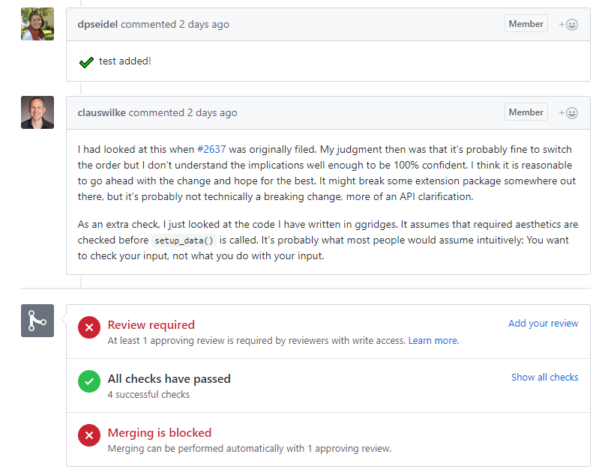

Slide 10
Interaction - Organizations
GitHub users can also form group or organizations that have their own profiles and repositories.
This could be used for research, teacher-student interaction, and meetup groups.
To create an organization:
(1) Go to your profile page
(2) Under the menu in the right corner select “settings”
(3) On the left hand side select “organizations”
(4) In the right corner select “new organization”
Picture 3: https://github.com/5802-InfoAnalytics

Slide 11
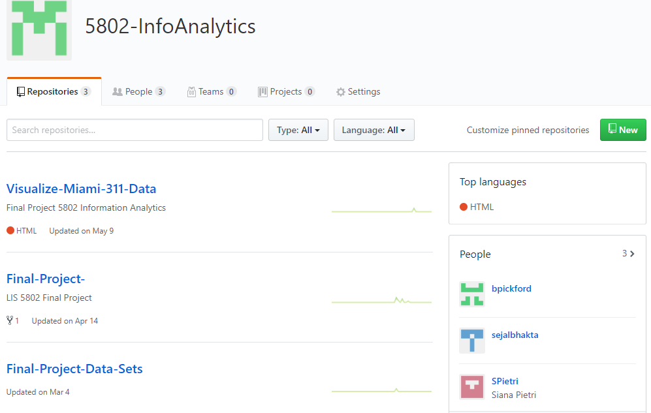

Slide 12
Creating Websites
GitHub Pages: https://pages.github.com/
The repository name followed by github.io [GitHub Pages]
Website will be https://website_name.github.io/the_page
In R you need:
csv file or data file
R markdown file saved as .html (this is done when you knit)
Then upload to GitHub repository
My Website: https://5802-infoanalytics.github.io/Visualize-Miami-311-Data/

Slide 13
Adding Packages
Individually load each folder of the package from your R project onto the Git Hub repository dedicated to the R project
In the README include the devtools code so others can load the package.
Install from GitHub : devtools::install_github("SPietri/Miami311p")
Include GitHub user name and the repository name

Slide 14
Additional Features
Blog Sites: http://thomas-keller.github.io/
Project Management Tools
Hosts several languages

Slide 15
Resources
[GitHub] https://guides.github.com/activities/hello-world/
[GitHub Pages] https://pages.github.com/
[University of Leicester] https://www2.le.ac.uk/services/research-data/organise-data/version-control

